Slide 1



TANGRAI
Pau Cutrina Vilalta
Carles pregonas graells
SAMIR KANAAN IZQUIERDO

Slide 2

INTRODUCTION
SCOPE
CURRENT STATE
PENDING TASKS

Slide 3
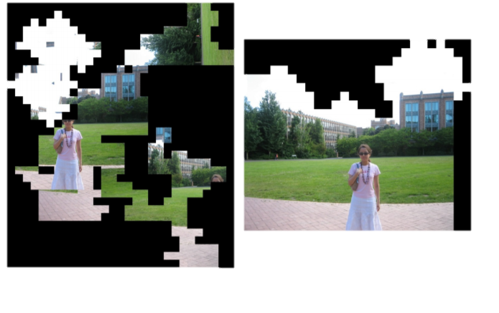
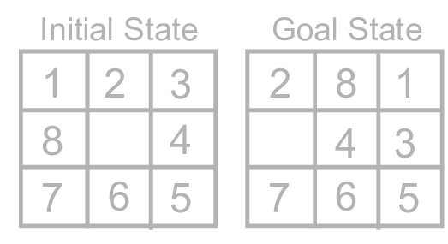
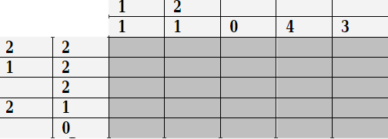
BACKGROUND
INTRODUCTION
Previous research done:
Puzzle
Rubik's cube
Tetris
Others:
https://pathak22.github.io/large-scale-curiosity/
https://blog.openai.com/reinforcement-learning-with-prediction-based-rewards/
https://sandipanweb.wordpress.com/2017/03/24/solving-4-puzzles-with-reinforcement-learning-q-learning-in-python/

Slide 4

Proposed project
INTRODUCTION
TangrAI goals:
Minimize the empty spaces.
Use all the seven pieces.

Slide 5
What are we looking for?
SCOPE
Project scope:
How many different positions achieve the goal?
Could be found any piece with only one possible result?
Space optimization
Design

Slide 6
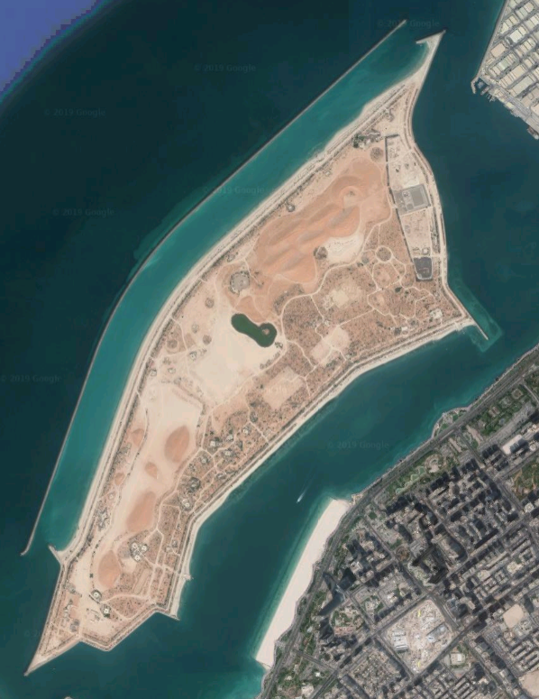
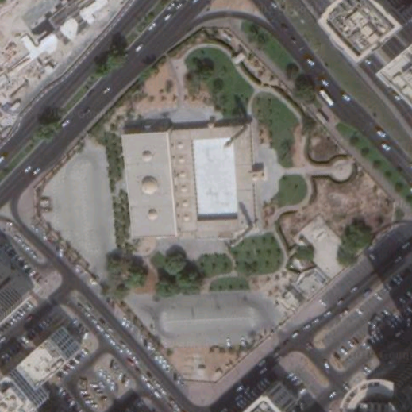
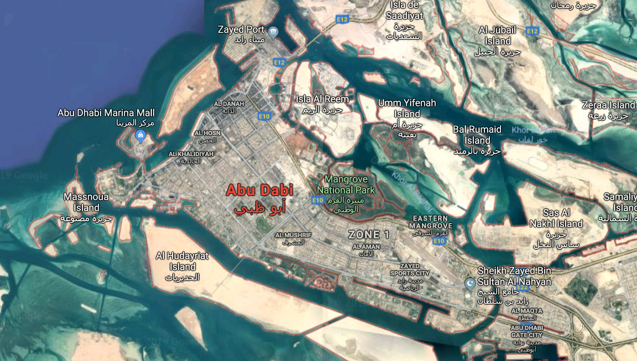
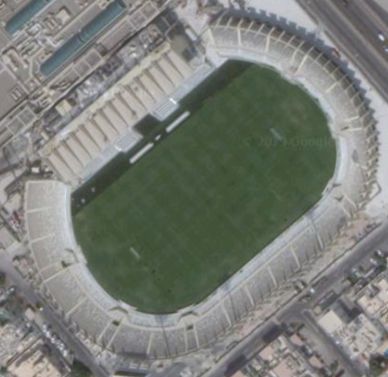
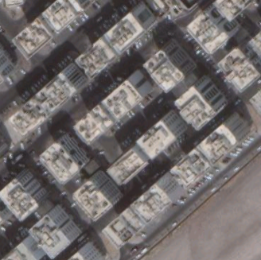
What are we looking for?
SCOPE
Goal: As much buildings as we can

Slide 7
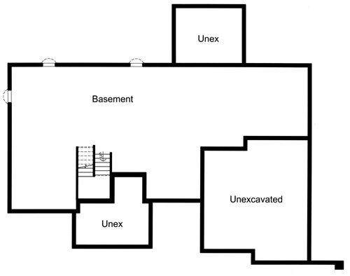
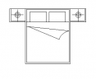
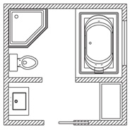
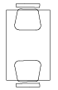
What are we looking for?
SCOPE
Goal: As better distributed as we can

Slide 8
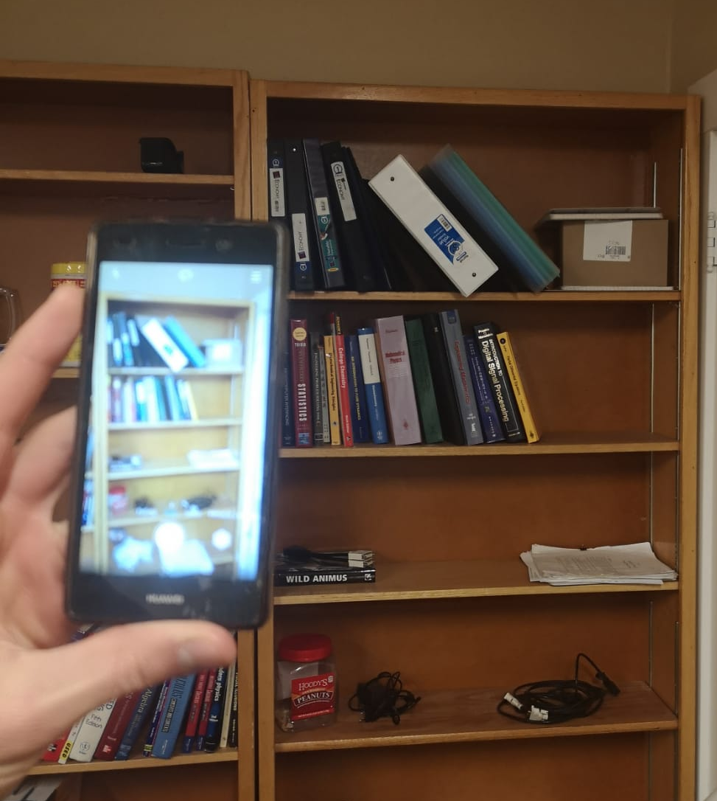
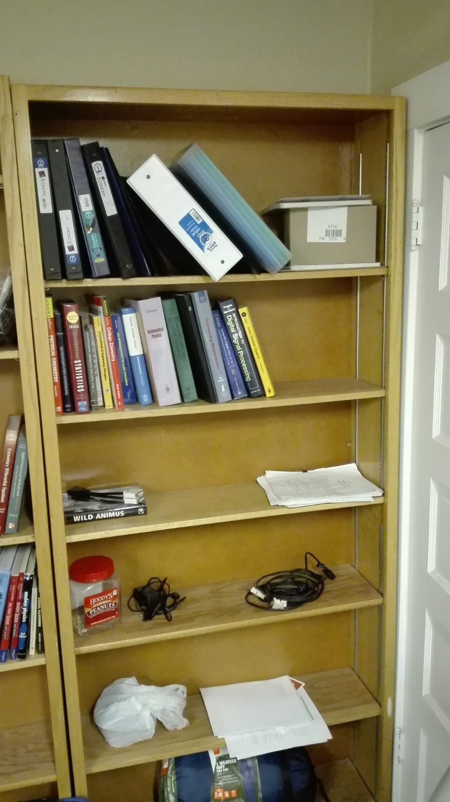
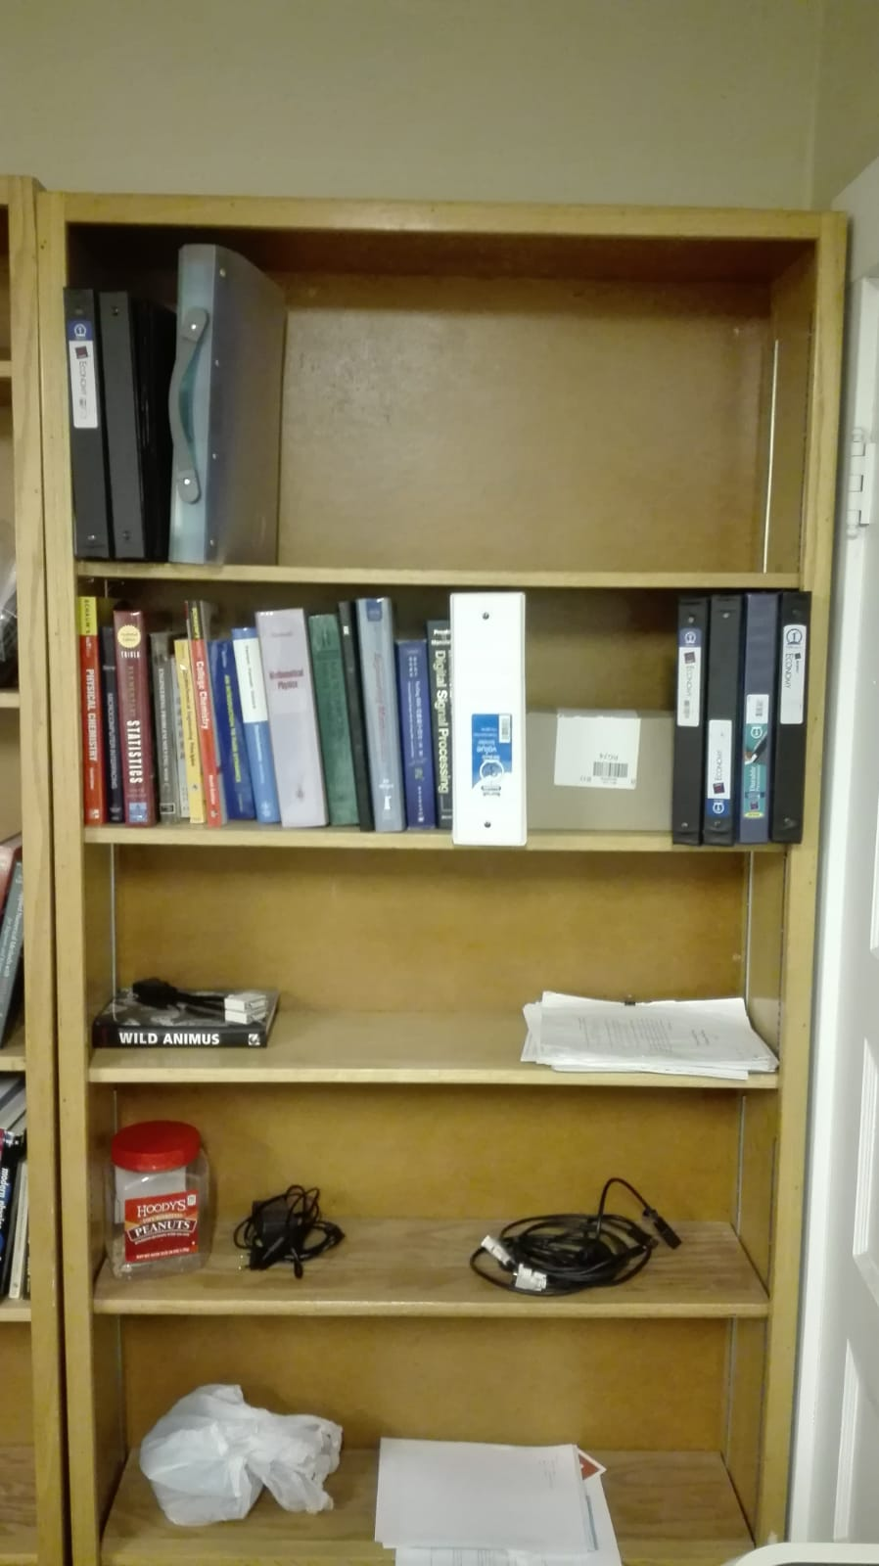
What are we looking for?
SCOPE
Goal: organize spaces using computer vision

Slide 9
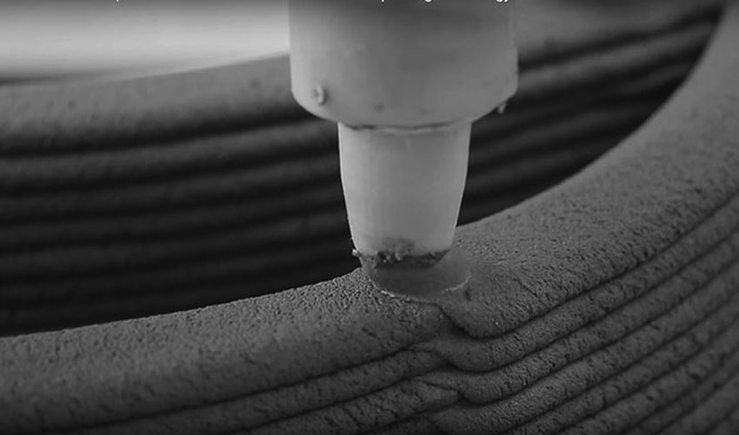
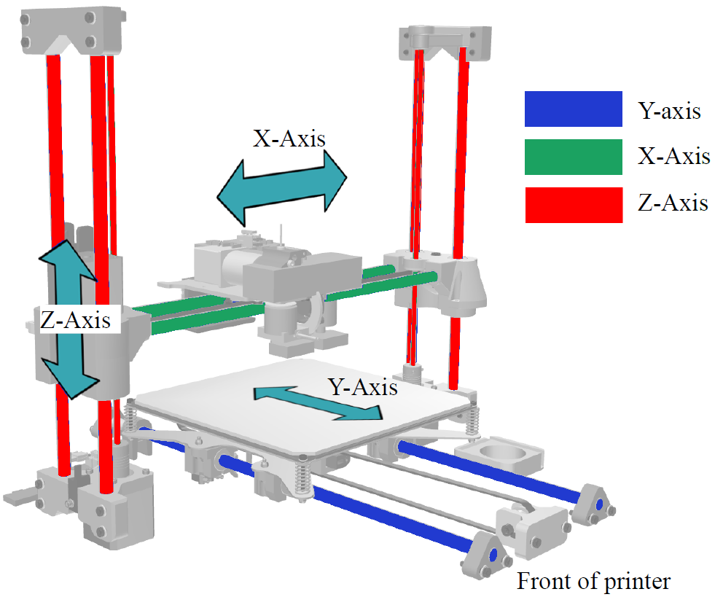
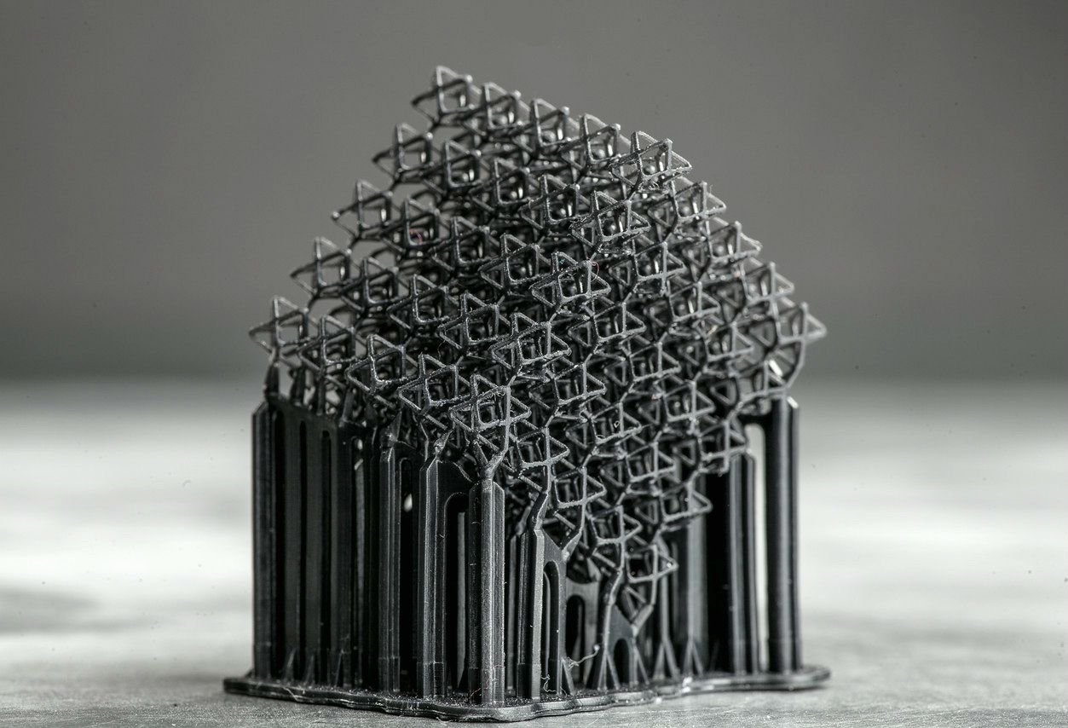
What are we looking for?
SCOPE
Goal: use less material as possible

Slide 10
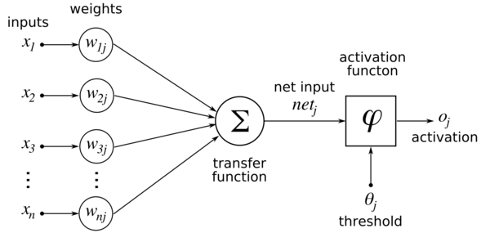
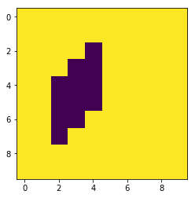
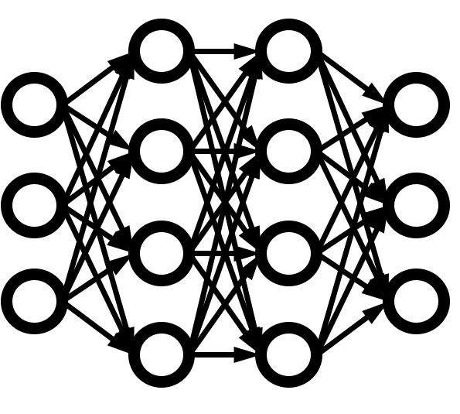
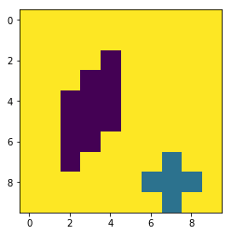






Structure
CURRENT STATE
replay
Q-Table
Initial state
New state
act
remember
Reward
State
Done
$$ℝ^{100}$$
$$ℝ^{1}$$
$$\left[00,01,02,...,97,98,99] \right.$$
$$85$$
Step

Slide 11
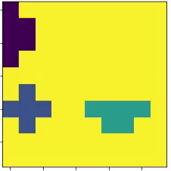
CURRENT STATE
Display example
HackathonCU\
setup.py
tangrai_agent.py
tangrai
__init__.py
envs\
__init__.py
tangrai_engine.py
tangrai_env.py
Create openAI environment
Execution and training
Environment registration
Import functions
Functionality
Connect engine and agent

Slide 12
CURRENT STATE
Current parameters
episodes=5000
max_env_steps=7
epsilon_decay=1
epsilon=0.8
epsilon_min=0.01
gamma=0.8
learning_rate=.001
alpha_decay=0.1
batch_size=4

Slide 13
PENDING TASKS
Pending tasks
Render the states.
Increase the evaluation techniques to improve the feedback.
Adjust the parameters.
Include rotations and random choice of each piece.
Test the results using unseen pieces.
Optimize the neural network.

Slide 14
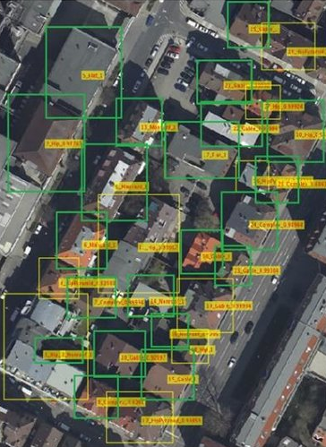
PENDING TASKS
Pending tasks
CNN to define the states → Generic algorithm

Slide 15

Contact details
paucutrina@gmail.com
carles.prego@gmail.com

